Slide 1
Grocery Gang
Zach Brill, Matt Turconi, Dan Kershner

Slide 2
What We’re Making
An algorithm that generates a grocery list. When implemented in a smart-fridge, it can keep track of previous food purchases as well as food usage, enabling it to better estimate how much food should be purchased every time you visit the grocer.

Slide 3
Design
Agent would accept a shopping list from a user.
It would use data based on the average quantity of a specific food item that a person would by each week and determine the quantity of each item to buy.
Agent would accept data from the previous week on how much food was used in an attempt to better predict what the user would need.
The Agent would then suggest items not on the user’s list to buy.

Slide 4
Design
In the event that the agent wants to suggest a quantity of food that is not available for purchase in a store, the Agent will always choose to over buy rather than under buy.
The reason being that consumers would rather have more of an item than less of one.

Slide 5
How Our Agent Could be Unethical
The agent may suggest larger quantities of food than a person actually needs, in order to ensure they are satisfied.
People would rather have too much food than run out of food and have to go back out to the store.
If this agent was widespread, over estimating could lead to extra food waste.
Companies may also be able to exploit the algorithm in various ways to encourage consumers to buy more of their products.

Slide 6
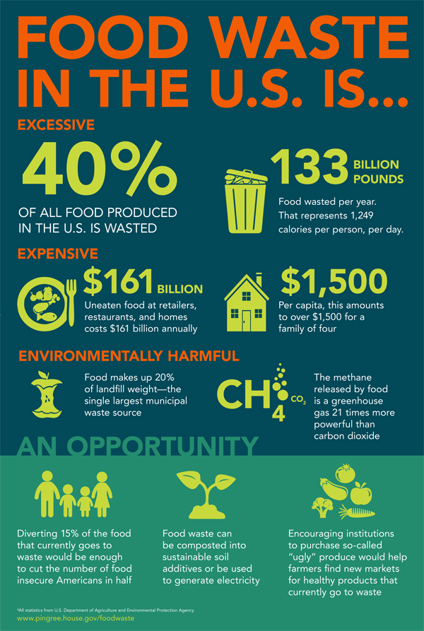
pingree.house.gov

